Slide 1
Meta-learning with Differentiable Convex Optimization
Chen Dalei
2019.10.8

Slide 2
1.Introduction
Many meta-learning approaches for few-shot learning rely on simple base learners such as nearest-neighbor classifiers. However,even in the few-shot regime, discriminatively trained linear predictors can offer better generalization[1].
Authors use these predictors as base learners to learn representations for few-shot learning and show they offer better tradeoffs between feature size and performance across a range of few-shot recognition benchmarks.
Linear predictors can exploit the negative examples which are often more abundant to learn better class boundaries. Moreover, they can effectively use high dimensional feature embeddings as model capacity can be controlled by appropriate regularization such as weight sparsity or norm.
Notes:
许多用于少数学习的元学习方法依赖于简单的基学习器，例如最近邻的分类学习者。然而，即使在少数射击机制中，经过区分训练的线性预测器也可以提供更好的泛化。
作者使用线性分类器作为基学习器来学习少样本学习的表示，并表明它们在一系列少数识别基准测试中提供了特征尺寸和性能之间更好的权衡。
它们可以利用通常更丰富的负面示例来学习更好的类边界。此外，它们可以有效地使用高维特征嵌入，因模型空间容量能够以合适的正则化如权重系数或范数来控制。

Slide 3
1.Introduction
A linear support vector machine (SVM) is used to learn a classifier given a set of labeled training examples and the generalization error is computed on a novel set of examples from the same task.
The key challenge is computational since the meta-learning objective of minimizing the generalization error across tasks requires training a linear classifier in the inner loop of optimization. However, the objective of linear models is convex and can be solved efficiently.
Two additional properties arising from the convex nature that allows efficient meta-learning: implicit differentiation of the optimization and the low-rank nature of the classifier in the few-shot setting.
Notes:
给定标注的训练样本集，线性SVM被用来学习分类器，泛化误差由相同任务的新样本集计算。
由于最小化不同任务的泛化误差的元学习目标，要求在内部以循环优化的方式来训练线性分类器，因此可计算性是一个关键的挑战；但是线性模型的目标函数是凸的，可以有效地被解决。
它引出两个额外属性：（优化的）隐式可微和（分类器的）低秩特性。

Slide 4
1.Introduction
1.Implicit differentiation of the optimization
It allows the use of off-the-shelf convex optimizers to estimate the optima and implicitly differentiate the optimality or Karush-Kuhn-Tucker (KKT) conditions to train embedding model.
2.The low-rank nature of the classifier in the few-shot setting.
It means that the number of optimization variables in the dual formation is far smaller than the feature dimension for fewshot learning.
Notes:
第一个属性允许使用已有凸优化估计最优值，并隐式地微分最优性条件或KKT条件来训练嵌入模型。
第二个属性意味着对少量样本学习而言，对偶形式中待优化的变量数量远远小于特征维数。

Slide 5
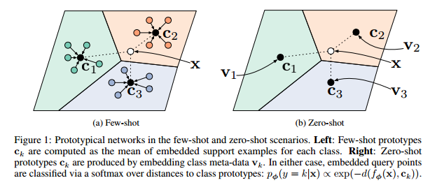
1.Introduction
Prototypical Network[2]
Fig. 1. Prototypical Network in few-shot
Notes:
原型网络示意图

Slide 6



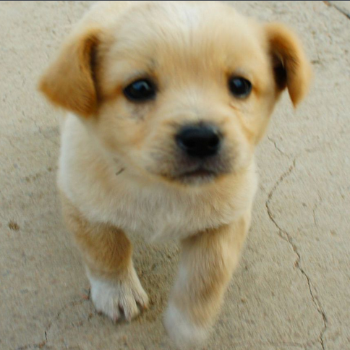


1.Introduction
Embeddings of
Training Examples
Weights of
Linear Classifler
Score(logit)
For Each Class
$$f_{φ}$$
SVM
$$f_{φ}$$
loss
Test Examples
Fig. 2. Outview of authors’ approach
Notes:
MetaOptNet在一次性3分类任务上的示意图。元训练目标是学习特征嵌入模型 的参数 ，当与正则化线性分类器（例如，SVM）一起使用时，该参数很好地概括了各个任务。任务是几次训练集和测试集的元组.

Slide 7
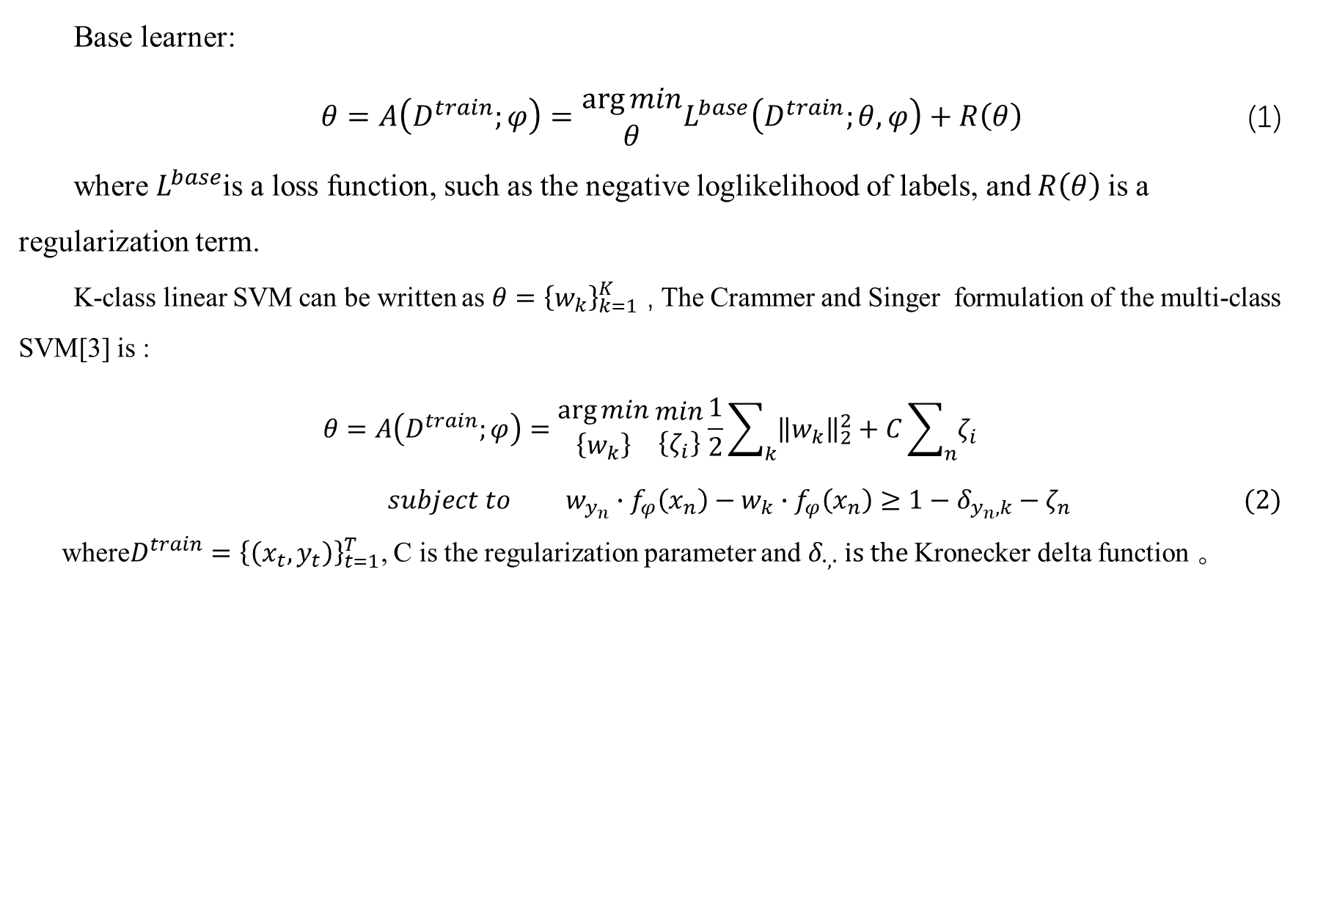
2.Meta-learning with Convex Base Learners
Base learner:
$θ=A\left(D^{train};φ\right)=\begin{matrix}\arg{min} \\ θ\end{matrix}L^{base}\left(D^{train};θ,φ\right)+R\left(θ\right)$ (1)
where $L^{base}$is a loss function, such as the negative loglikelihood of labels, and $R\left(θ\right)$is a regularization term.
K-class linear SVM can be written as $θ={\left\{w_{k}\right\}}_{k=1}^{K}$ , The Crammer and Singer formulation of the multi-class SVM[3] is :
$$θ=A\left(D^{train};φ\right)=\begin{matrix}\arg{min} \\ \left\{w_{k}\right\}\end{matrix} \begin{matrix}min \\ \left\{ζ_{i}\right\}\end{matrix}\frac{1}{2}\sum_{k}{{\left\|w_{k}\right\|}_{2}^{2}+C\sum_{n}{ζ_{i}}}$$
$subject to w_{y_{n}}∙f_{φ}\left(x_{n}\right)−w_{k}∙f_{φ}\left(x_{n}\right)≥1−δ_{y_{n},k}−ζ_{n}$ $(2)$
where$D^{train}={\left\{\left(x_{t},y_{t}\right)\right\}}_{t=1}^{T}$, C is the regularization parameter and $δ_{∙,∙} is the$Kronecker delta function 。
Notes:
基学习器模型
SVM-CS表达式

Slide 8

2.Meta-learning with Convex Base Learners
Let
$$w_{k}\left(α^{k}\right)=\sum_{n}{α_{n}^{k}f_{φ}\left(x_{n}\right) ∀k . \left(3\right) }$$
optimize in the dual space :
$$\begin{matrix}max \\ \left\{α^{k}\right\}\end{matrix}[−\frac{1}{2}\sum_{k}{{\left\|w_{k}\left(α^{k}\right)\right\|}_{2}^{2}+\sum_{n}{α_{n}^{y_{n}}]}} \left(4\right)$$
$$subject to$$
$$α_{n}^{y_{n}}≤C,α_{n}^{k}≤0 ∀k≠y_{n},\sum_{k}{α_{n}^{k}=0 ∀n.}$$
Notes:
求对偶形式
这产生了一个在对偶变量上的二次规划（QP），注意这里优化变量的数量是训练样本数量乘以类数，对于少样本学习而言这通常要比特征维度的数量要小。使用[OptNet:differentiable optimization as a layer in neural networks]（实现了一个可微的基于GPU的QP求解器）解方程的对偶二次规划。

Slide 9
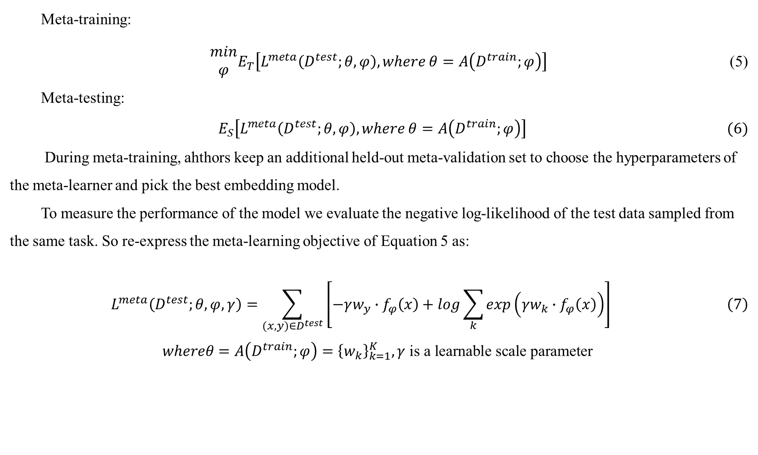
2.Meta-learning with Convex Base Learners
Meta-training:
$\begin{matrix}min \\ φ\end{matrix}E_{T}\left[L^{meta}\left(D^{test};θ,φ\right),where θ=A\left(D^{train};φ\right)\right]$ (5)
Meta-testing:
$E_{S}\left[L^{meta}\left(D^{test};θ,φ\right), where θ=A\left(D^{train};φ\right)\right] (6)$
During meta-training, ahthors keep an additional held-out meta-validation set to choose the hyperparameters of the meta-learner and pick the best embedding model.
To measure the performance of the model we evaluate the negative log-likelihood of the test data sampled from the same task. So re-express the meta-learning objective of Equation 5 as:
$$L^{meta}\left(D^{test};θ,φ,γ\right)=\sum_{(x,y)∈D^{test}}{\left[−γw_{y}∙f_{φ}\left(x\right)+log\sum_{k}{exp\left(γw_{k}∙f_{φ}\left(x\right)\right)}\right]} \left(7\right)$$
$$whereθ=A\left(D^{train};φ\right)={\left\{w_{k}\right\}}_{k=1}^{K},γ \text{is} \text{a} \text{learnable} \text{scale} \text{parameter}$$
Notes:
在元训练阶段中，保持额外的held-out meta-validation 集来选择元学习器的超参和挑选最好的嵌入模型；
为了度量模型的性能，从相同任务采样出测试数据来计算负对数似然。因此，可以重新表达方程5的元学习目标为：

Slide 10
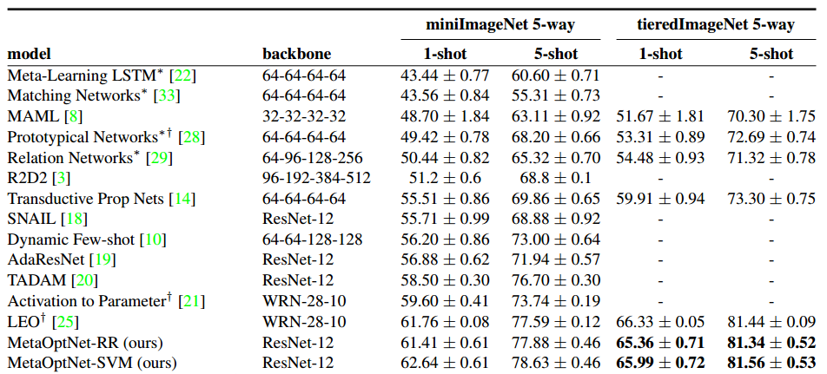
3.Experiments

Slide 11
Reference
[1] Kwonjoon Lee ,et al.Meta-Learning with Differentiable Convex Optimization.In CVPR.2019
[2] Jake Snell, Kevin Swersky, and Richard S. Zemel. Prototypical networks for few-shot learning. In NIPS, 2017. [3] Koby Crammer and Yoram Singer. On the algorithmic implementation of multiclass kernel-based vector machines. J.Mach. Learn. Res., 2:265–292, Mar. 2002.

Slide 12
THANK
YOU

